Slide 1




GRADE 10 · ALGEBRA II · TOPIC 3
Lesson 3-4
Dividing
Polynomials
Journey of 6 stations, 60 minutes
Polynomial Functions
Mr Malek Thiab
FAITH, RIGHTEOUSNESS AND WISDOM
Notes:
Speaker notes: Welcome to Lesson 3-4: Dividing Polynomials.
Timing: 60 minutes (Diagnose 6, Targeted Instruction 18, Practice 12, Production 12, Mastery Gate 6, Smart Production 6). For a 40-minute class scale every station by two thirds.
The journey map on the next slide shows the six stations; in slideshow mode the Morph transition zooms the station circles into the breadcrumb at the top of every later slide.

Slide 2


Today's journey
Six stations. Each one zooms in as we arrive.
Targeted Instruction
18 min
Production
12 min
Smart Production
6 min
2
4
6
1
3
5
Diagnose
6 min
Practice
12 min
Mastery Gate
6 min
FAITH, RIGHTEOUSNESS AND WISDOM
Notes:
Speaker notes: This is the whole map. Walk it left to right: Diagnose (what we already know), Targeted Instruction (Quotient and remainder; Synthetic division; The Remainder Theorem; The Factor Theorem), Practice (Practice, Apply, Investigate), Production (Freight crate for the rail terminal), Mastery Gate (three questions to pass), Smart Production (create, then Time to Check).
In slideshow mode the Morph transition animates these circles shrinking into the breadcrumb on later slides; without Morph the slides fade.
Ask the class which station they think will be hardest.

Slide 3
What we are learning
OBJECTIVES
VOCABULARY
Identify quotients and remainders upon the division of polynomials.
Apply the Remainder Theorem and the Factor Theorem.
Use synthetic division to divide a polynomial by a linear polynomial with leading coefficient 1.
Divisor
factor
Polynomial
long division
proper rational function
Quotient
Remainder
synthetic division
STANDARDS
HSA.APR.B.2 Know and apply the Remainder Theorem: For a polynomial p(x) and a number a, the remainder on division by x - a is p(a), so p(a) = 0 if and only if (x - a) is a factor of p(x).
HSA.APR.D.6 Rewrite simple rational expressions in different forms; write a(x)/b(x) in the form q(x) + r(x)/b(x), where a(x), b(x), q(x), and r(x) are polynomials with the degree of r(x) less than the degree of b(x), using inspection, long division, or, for the more complicated examples, a computer algebra system.
HSA.SSE.A.2 Use the structure of an expression to identify ways to rewrite it.
HSA.APR.B.2 · HSA.APR.D.6 · HSA.SSE.A.2
FAITH, RIGHTEOUSNESS AND WISDOM
Mr Malek Thiab · 3
Notes:
Speaker notes: Read the objectives aloud one at a time and have students say which one they feel least sure about.
Vocabulary used today: Divisor, factor, Polynomial, long division, proper rational function, Quotient, Remainder, synthetic division.
Standards are listed on this slide.
The essential question and mathematical practices are not shown because they are not in the project documents; add them from the curriculum map if you want them displayed.

Slide 4
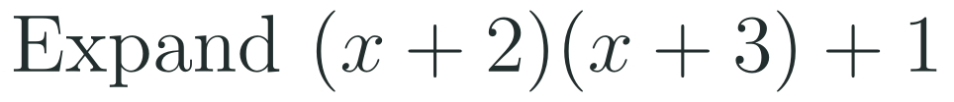
1
2
3
4
5
6
STATION 1 · DIAGNOSE · 6 MIN
Start here: three quick checks
1
2
3
Done when
All three answers are written without a calculator, and you can say how Question 3 and Question 2 are alike.
HSA.APR.B.2 · HSA.APR.D.6 · HSA.SSE.A.2
FAITH, RIGHTEOUSNESS AND WISDOM
Mr Malek Thiab · 4
Notes:
Speaker notes (Diagnose, 6 min, no calculator):
Answers. Q1: 4 − 6 + 5 = 3. Q2: x² + 5x + 6 + 1 = x² + 5x + 7. Q3: 17 = 3 × 5 + 2, quotient 3, remainder 2. Q2 and Q3 are alike: dividend = divisor × quotient + remainder, the idea behind polynomial division. Verbal misconceptions: Q1 students square −3x as 9x or compute 2² as 4 and then 4 − 3 + 5 slip to 6; Q2 students forget to add the 1 or write 5x² ; Q3 students write 3.4 and do not give a remainder. Adaptive routing: if >30% miss Q1, rehearse substitution with brackets before slide 7; if >30% miss Q2, expand with a grid before slide 5; if >30% miss Q3, write 17 = 5 × 3 + 2 and go to slide 5. If all three are secure, move quickly through slide 5 and start the Investigate route early.

Slide 5


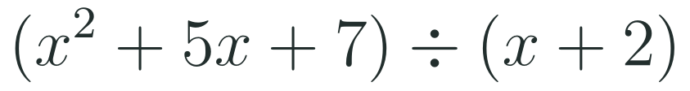
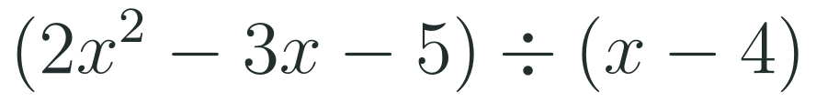


1
2
3
4
5
6
STATION 2 · TARGETED INSTRUCTION · 18 MIN
Quotient and remainder
EXAMPLE A
EXAMPLE B
HSA.APR.B.2 · HSA.APR.D.6 · HSA.SSE.A.2
FAITH, RIGHTEOUSNESS AND WISDOM
Mr Malek Thiab · 5
Notes:
Speaker notes (Targeted Instruction, block 1 of 4):
Worked solutions (HSA.APR.D.6). Polynomial division mirrors 17 ÷ 5 = 3 remainder 2: the DIVIDEND equals the DIVISOR times the QUOTIENT plus the REMAINDER, and the remainder has smaller degree than the divisor. Long division: Example A: x² ÷ x = x, so the first quotient term is x; x(x + 2) = x² + 2x; subtract: 3x + 7; 3x ÷ x = 3; 3(x + 2) = 3x + 6; subtract: 1. Quotient x + 3, remainder 1. Check: (x + 2)(x + 3) + 1 = x² + 5x + 6 + 1 ✓. Example B: 2x² ÷ x = 2x; 2x(x − 4) = 2x² − 8x; subtract: 5x − 5; 5x ÷ x = 5; 5(x − 4) = 5x − 20; subtract: 15. Quotient 2x + 5, remainder 15. Check: 2x² − 8x + 5x − 20 + 15 = 2x² − 3x − 5 ✓. In rational form (a proper rational function has remainder degree less than the divisor degree): (x² + 5x + 7)/(x + 2) = x + 3 + 1/(x + 2). Verbal misconceptions: subtracting only the first term of each product (sign errors in the second term, −8x subtracted as +8x); leaving a remainder of the same degree as the divisor; forgetting to write the remainder over the divisor. Adaptive routing: if >30% slip on the subtraction, write the subtraction as 'change every sign' and redo Example B; if >30% forget the remainder, link to 17 = 3 × 5 + 2. Gate Q2 routes to slide 5 or 6.

Slide 6
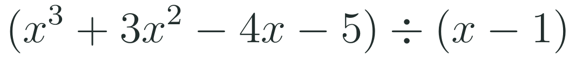
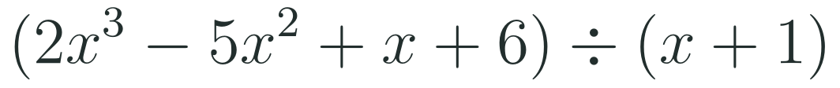


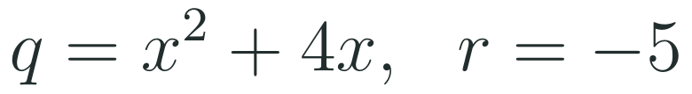
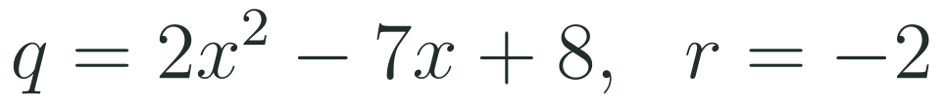
1
2
3
4
5
6
STATION 2 · TARGETED INSTRUCTION · 18 MIN
Synthetic division
EXAMPLE A
EXAMPLE B
HSA.APR.B.2 · HSA.APR.D.6 · HSA.SSE.A.2
FAITH, RIGHTEOUSNESS AND WISDOM
Mr Malek Thiab · 6
Notes:
Speaker notes (Targeted Instruction, block 2 of 4):
Worked solutions (HSA.APR.B.2 and D.6). Synthetic division is a shortcut for dividing by a LINEAR divisor x − a with leading coefficient 1. Write a in the box (the opposite sign to the constant in the divisor) and the coefficients of the dividend, including zeros for missing powers. Bring down the first coefficient; multiply by a and add to the next; repeat. The last number is the remainder and the others are the quotient coefficients, one degree lower. Example A: box 1; coefficients 1, 3, −4, −5. Bring down 1; 1 × 1 = 1, 3 + 1 = 4; 4 × 1 = 4, −4 + 4 = 0; 0 × 1 = 0, −5 + 0 = −5. Quotient x² + 4x + 0, remainder −5. Check at x = 2: p(2) = 8 + 12 − 8 − 5 = 7 and (2 − 1)(4 + 8) − 5 = 7 ✓. Example B: divisor x + 1, so the box is −1. Coefficients 2, −5, 1, 6. Bring down 2; 2 × (−1) = −2, −5 − 2 = −7; −7 × (−1) = 7, 1 + 7 = 8; 8 × (−1) = −8, 6 − 8 = −2. Quotient 2x² − 7x + 8, remainder −2. Verbal misconceptions: using +1 instead of −1 for x + 1; omitting the zero for a missing power; reading the last number as part of the quotient; trying it for 2x − 3 (leading coefficient not 1). Adaptive routing: if >30% use the wrong sign in the box, write 'x − a, so the box holds a' and redo Example B; if >30% skip the zero, show x³ − 7x + 6 with 0x². Gate Q1 routes to this slide.

Slide 7
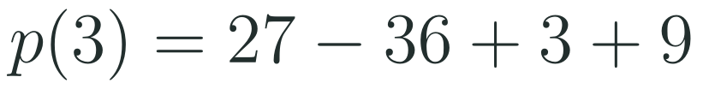
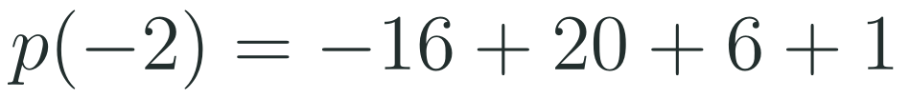


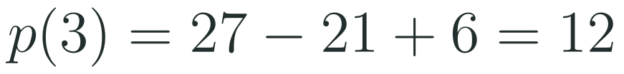
1
2
3
4
5
6
STATION 2 · TARGETED INSTRUCTION · 18 MIN
The Remainder Theorem
EXAMPLE A
EXAMPLE B
WHAT IF...?
What if the divisor is x − 3 and p(x) = x³ − 7x + 6? Predict the remainder from p(3), then check by synthetic division.
HSA.APR.B.2 · HSA.APR.D.6 · HSA.SSE.A.2
FAITH, RIGHTEOUSNESS AND WISDOM
Mr Malek Thiab · 7
Notes:
Speaker notes (Targeted Instruction, block 3 of 4):
Worked solutions (HSA.APR.B.2). Why it works: if p(x) = (x − a)q(x) + r, then substituting x = a makes the first term zero and leaves p(a) = r. So the remainder is found by substitution, with no division. Example A: p(3) = 27 − 36 + 3 + 9 = 3. Check by synthetic division, box 3: 1, −4 + 3 = −1, 1 − 3 = −2, 9 − 6 = 3 ✓. Example B: divisor x + 2 = x − (−2), so a = −2: p(−2) = 2(−8) + 5(4) − 3(−2) + 1 = −16 + 20 + 6 + 1 = 11. Check, box −2: 2, 5 − 4 = 1, −3 − 2 = −5, 1 + 10 = 11 ✓. What if (gold strip): p(3) = 27 − 21 + 6 = 12; synthetic division, box 3, coefficients 1, 0, −7, 6: 1, 3, 2, 12 ✓, so the remainder is 12. Verbal misconceptions: evaluating p(−3) for the divisor x − 3 (opposite sign); evaluating p(a) but calling it the quotient; arithmetic slips with negative cubes. Adaptive routing: if >30% use the wrong sign, ask 'what makes the divisor zero?' and redo Example B; if >30% slip with (−2)³, show (−2)³ = −8 in brackets. Gate Q2 routes to this slide.

Slide 8
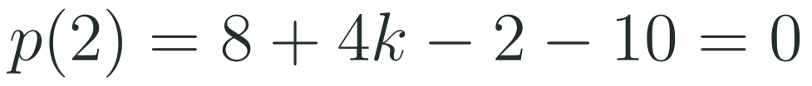


1
2
3
4
5
6
STATION 2 · TARGETED INSTRUCTION · 18 MIN
The Factor Theorem
EXAMPLE A
EXAMPLE B
WHAT IF...?
What if x + 4 is tested on the same cubic? Predict p(−4) before you substitute, then use it to confirm the factorisation.
HSA.APR.B.2 · HSA.APR.D.6 · HSA.SSE.A.2
FAITH, RIGHTEOUSNESS AND WISDOM
Mr Malek Thiab · 8
Notes:
Speaker notes (Targeted Instruction, block 4 of 4):
Worked solutions (HSA.APR.B.2). FACTOR THEOREM: p(a) = 0 exactly when x − a is a factor. Example A: try small integer values: p(−1) = −1 + 2 + 11 − 12 = 0, so x + 1 is a factor. Synthetic division with box −1: 1; 2 − 1 = 1; −11 − 1 = −12; −12 + 12 = 0. Quotient x² + x − 12 = (x + 4)(x − 3). So p(x) = (x + 1)(x + 4)(x − 3). Check p(3) = 27 + 18 − 33 − 12 = 0 ✓ and p(−4) = −64 + 32 + 44 − 12 = 0 ✓. Example B: p(2) = 8 + 4k − 2 − 10 = 4k − 4 = 0, so k = 1. Check: x³ + x² − x − 10 at x = 2 is 8 + 4 − 2 − 10 = 0 ✓. What if (gold strip): p(−4) = 0 as computed, which confirms that x + 4 is a factor. Verbal misconceptions: testing p(1) for the factor x + 1; stopping after finding one factor and not factoring the quotient; believing a non-zero remainder means 'no solutions'. Adaptive routing: if >30% test the wrong sign, repeat 'what number makes the factor zero?'; if >30% stop at the quadratic, ask them to factor it. Gate Q3 routes to this slide.

Slide 9
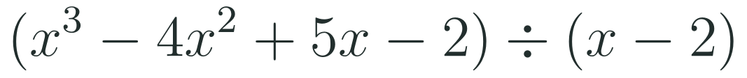
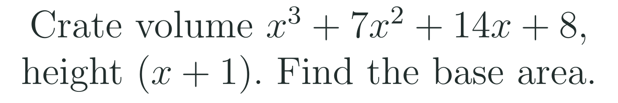
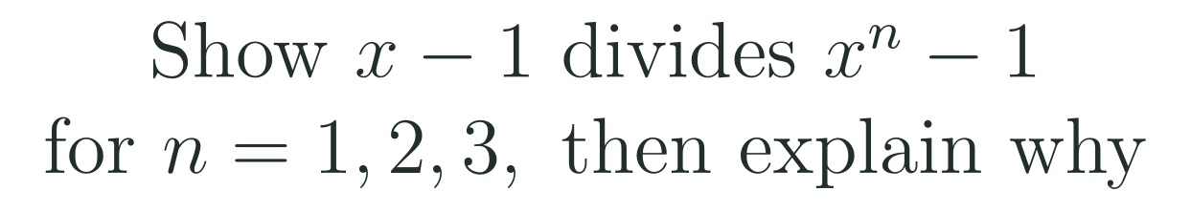
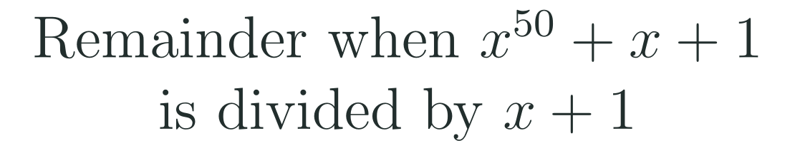
1
2
3
4
5
6
STATION 3 · PRACTICE · 12 MIN
Give it a go: Practice, Apply, Investigate
PRACTICE
APPLY
INVESTIGATE
Secure the method
Use it in context
Find out why
Done when: the box number has the opposite sign to the constant in the divisor, the last number is read as the remainder, and the answer is checked by substituting.
Done when: the divisor is written as x − a first, the Remainder Theorem is used when only a remainder is needed, and each answer is checked.
Done when: your argument uses p(a) or the form p(x) = (x − a)q(x) + r, and the explanation says why it holds for every n.
HSA.APR.B.2 · HSA.APR.D.6 · HSA.SSE.A.2
FAITH, RIGHTEOUSNESS AND WISDOM
Mr Malek Thiab · 9
Notes:
Speaker notes (Practice, 12 min; tierless differentiation: students choose the starting column and may move across):
Answers. Practice 1: box 2, coefficients 1, −4, 5, −2: 1, −2, 1, 0 gives x² − 2x + 1, remainder 0 (so x − 2 is a factor). Practice 2: p(2) = 8 + 2 − 9 = 1. Apply 1 (a model freight crate for a Jeddah rail terminal, model values): box −1, coefficients 1, 7, 14, 8: 1, 6, 8, 0; the base area is x² + 6x + 8 = (x + 2)(x + 4); check: (x + 1)(x² + 6x + 8) = x³ + 7x² + 14x + 8 ✓. Apply 2: p(−1) = −1 + k + 4 − 6 = k − 3 = 0, so k = 3. Investigate 1: put x = 1 in x^n − 1: 1 − 1 = 0, so by the Factor Theorem x − 1 is a factor for every n; for n = 3 the quotient is x² + x + 1. Investigate 2: x + 1 = x − (−1), so a = −1 and the remainder is p(−1) = 1 − 1 + 1 = 1 (since (−1)^50 = 1). Verbal misconceptions: Practice 1 using −2 in the box; Practice 2 computing p(−2); Apply 1 forgetting the final 0 means no remainder; Apply 2 substituting x = 1; Investigate 2 saying (−1)^50 = −1. Adaptive routing: if >30% miss Practice 1, route to slide 6; Practice 2, slide 7; Apply 1, slide 6; Apply 2, slide 8; Investigate, slide 7 or 8. Students who finish Apply early move to Investigate.

Slide 10
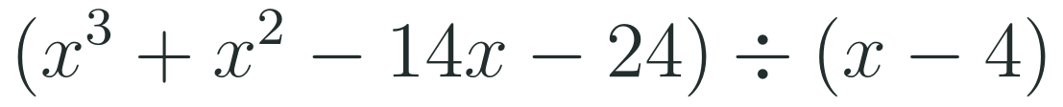

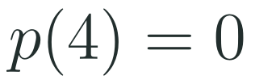
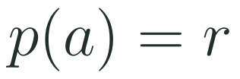
1
2
3
4
5
6
STATION 3 · PRACTICE · 12 MIN
Which route? Judge the claim
LONG DIVISION
SYNTHETIC DIVISION
REMAINDER THEOREM
JUDGE THE CLAIM
Dividing by x − 3 and by x + 3 always gives the same remainder.
+ Works for any divisor.
+ Short and tidy for x − a.
+ Tests a factor in one line.
TRUE
FALSE
SOMETIMES
− Many lines and sign slips.
− Only for a linear divisor with leading 1.
− Gives the remainder only, not the quotient.
CHECK THE ASSUMPTION
Did you test more than one polynomial and both signs of a?
SPOTLIGHT: STEAL THIS SHORTCUT
WHAT IF...?
To test a possible factor, substitute first. If p(a) is not zero you have just found the remainder, so no division is wasted.
What if the remainder is 0? Predict what that tells you about the graph of p, then check with p(x) = x³ + x² − 14x − 24 at x = 4.
HSA.APR.B.2 · HSA.APR.D.6 · HSA.SSE.A.2
FAITH, RIGHTEOUSNESS AND WISDOM
Mr Malek Thiab · 10
Notes:
Speaker notes (inside Station 3, 3 minutes, after the Practice work):
Compare and judge (3 min). Worked solutions. Divide p(x) = x³ + x² − 14x − 24 by x − 4. Long division: x³ ÷ x = x²; x²(x − 4) = x³ − 4x²; subtract: 5x² − 14x; 5x² ÷ x = 5x; 5x(x − 4) = 5x² − 20x; subtract: 6x − 24; 6(x − 4) = 6x − 24; remainder 0. Quotient x² + 5x + 6. Synthetic: box 4: 1, 5, 6, 0. Remainder Theorem: p(4) = 64 + 16 − 56 − 24 = 0, so x − 4 is a factor, and (x − 4)(x + 2)(x + 3) is the full factorisation. Claim: FALSE. Take p(x) = x² + x: p(3) = 12 and p(−3) = 6, different remainders. (It holds for an even polynomial such as x², which is the trap.) What if (gold box): a zero remainder means p(4) = 0, so the graph crosses the x-axis at x = 4. Verbal misconceptions: 'x − 3 and x + 3 are the same factor'; 'a remainder of zero means no quotient'; 'synthetic division always works'. Adaptive routing: if >30% mark the claim TRUE, have them compute p(3) and p(−3) for x² + x; if teams finish early, ask which route they would choose for 2x − 3 as a divisor and why.

Slide 11
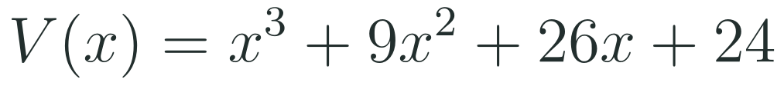

1
2
3
4
5
6
STATION 4 · PRODUCTION · 12 MIN
Production: Freight crate for the rail terminal
THE MODEL
DONE WHEN
A model freight crate for a Haramain rail terminal in Jeddah (model values only, not real data) has volume V(x) = x³ + 9x² + 26x + 24 cubic metres. Its height is (x + 2) m, and the base is a rectangle.
The box number is −2 and the base area is x² + 7x + 12.
The base factors as (x + 3)(x + 4) and the dimensions at x = 3 are 5, 6 and 7 m.
The volume 210 m³ is checked as 5 × 6 × 7.
The remainder 6 is found with p(−2) and is explained as a non-exact fit.
Use synthetic division to find the base area, and factor it into the two sides of the base.
Find the three dimensions when x = 3 and check the volume.
A second crate has volume x³ + 9x² + 26x + 30 with the same height (x + 2). Find the remainder and say what it means.
Hint for solving: the divisor x + 2 is x − (−2), so the box holds −2.
WHAT IF...?
What if the height is (x + 3) for the first crate? Predict whether it is also a fit, using p(−3), then find the base area.
HSA.APR.B.2 · HSA.APR.D.6 · HSA.SSE.A.2
FAITH, RIGHTEOUSNESS AND WISDOM
Mr Malek Thiab · 11
Notes:
Speaker notes (Production, 12 min):
Model values only, not real data. Task 1: box −2, coefficients 1, 9, 26, 24: 1; 9 − 2 = 7; 26 − 14 = 12; 24 − 24 = 0. Base area x² + 7x + 12 = (x + 3)(x + 4). Task 2: at x = 3 the height is 5, the base sides are 6 and 7, so the volume is 5 × 6 × 7 = 210 m³; check V(3) = 27 + 81 + 78 + 24 = 210 ✓. Task 3: p(−2) = −8 + 36 − 52 + 30 = 6, so the remainder is 6 and the height x + 2 is NOT a factor: the volume is not exactly height × base, there is 6 m³ left over. What if (gold box): p(−3) = −27 + 81 − 78 + 24 = 0, so x + 3 is also a factor; box −3: 1, 6, 8, 0, base area x² + 6x + 8 = (x + 2)(x + 4); the three factors are x + 2, x + 3, x + 4. Verbal misconceptions: using +2 in the box; forgetting that a remainder of zero is needed for an exact fit; answering Task 2 with 3, 4 and 5 (confusing x and the dimensions). Adaptive routing: if >30% cannot start Task 1, return to slide 6 Example B; if >30% miss Task 3, slide 7; if >30% miss the factorisation, slide 8. Early finishers: show that x + 4 is also a factor of V(x).

Slide 12
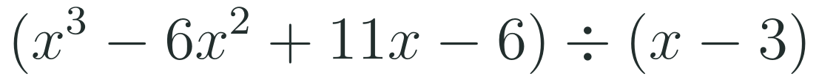
1
2
3
4
5
6
STATION 5 · MASTERY GATE · 6 MIN
Mastery Gate: three questions to pass
1
2
3
Pass mark
3 of 3 correct unlocks Station 6. Fewer than that: return to the slide for the question you missed, redo it, then re-take the gate.
HSA.APR.B.2 · HSA.APR.D.6 · HSA.SSE.A.2
FAITH, RIGHTEOUSNESS AND WISDOM
Mr Malek Thiab · 12
Notes:
Speaker notes (Mastery Gate, 6 min, no calculator):
Answers. Q1: box 3, coefficients 1, −6, 11, −6: 1, −3, 2, 0; quotient x² − 3x + 2 and remainder 0 (so x − 3 is a factor). Q2: p(−3) = −27 + 27 + 3 + 5 = 8. Q3: p(−1) = −1 + k + 4 − 6 = k − 3 = 0, so k = 3. Verbal misconceptions: Q1 using −3 in the box, or reading the 0 as part of the quotient; Q2 evaluating p(3) = 27 + 27 − 3 + 5 = 56; Q3 substituting x = 1. Adaptive routing: Q1 missed, route to slide 6; Q2 missed, slide 7; Q3 missed, slide 8. If a student misses two or more, they join the teacher group for the Smart Production create step; students who get all three correct start the create step immediately.

Slide 13
1
2
3
4
5
6
STATION 6 · SMART PRODUCTION · 6 MIN
Smart Production: make one, then check it
CREATE
TIME TO CHECK
Choose a quadratic with two integer zeros and multiply by one more factor to build a cubic p(x).
Use the Factor Theorem to show one of your factors, and divide to check the quotient.
Swap with a partner and check their work. Then add a What if...? question (change one coefficient) and test your prediction.
Exit ticket: write your answer on a sticky note and place it on the door.
Done when: your cubic expands correctly, the Factor Theorem check and the division agree, and your What if...? question has a prediction and a test.
Next lesson: more on zeros of polynomial functions.
HSA.APR.B.2 · HSA.APR.D.6 · HSA.SSE.A.2
FAITH, RIGHTEOUSNESS AND WISDOM
Mr Malek Thiab · 13
Notes:
Speaker notes (Smart Production, 6 min):
Exit ticket solutions. Exit 1: p(3) = 27 − 6 + 5 = 26. Exit 2: p(−2) = −8 + 4 + 8 − 4 = 0, so yes, x + 2 is a factor; the quotient (box −2: 1, −1, −2, 0) is x² − x − 2 = (x − 2)(x + 1). Create step example: (x − 1)(x + 3) = x² + 2x − 3; times (x − 2): x³ − 7x + 6; p(1) = 0 ✓, box 1: 1, 1, −6, 0, quotient x² + x − 6 = (x − 2)(x + 3) ✓. What if: changing the constant to 7 gives p(1) = 1, so x − 1 is no longer a factor and the remainder is 1. Verbal misconceptions: Exit 1 using p(−3); Exit 2 stopping at p(−2) = 0 without answering 'yes'. Adaptive routing: if >30% miss Exit 1, retrieve slide 7 Example A; if >30% miss Exit 2, retrieve slide 8 Example A.

Slide 14
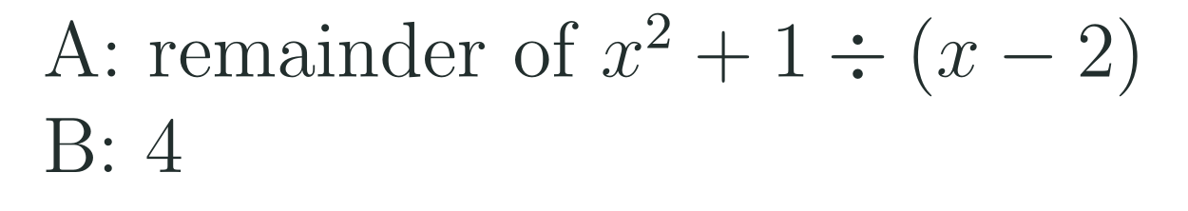

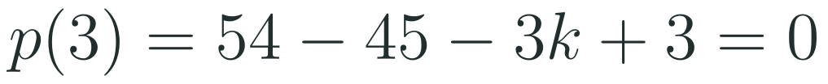
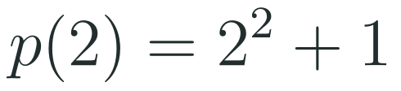
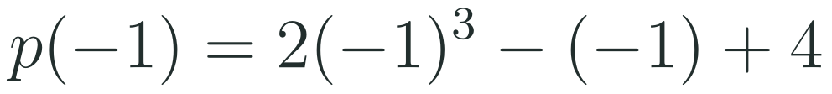






Exam connections
SAT
GAT
SAAT
STEPS
STEPS
STEPS
1
1
1
2
2
2
3
3
3
HSA.APR.B.2 · HSA.APR.D.6 · HSA.SSE.A.2
FAITH, RIGHTEOUSNESS AND WISDOM
Mr Malek Thiab · 14
Notes:
Speaker notes: each exam item is worked in numbered steps.
SAT (Advanced Math, polynomial factors): x − 3 a factor means p(3) = 0. p(3) = 2(27) − 5(9) − 3k + 3 = 54 − 45 + 3 − 3k = 12 − 3k = 0, so k = 4. Traps: using x = −3 (which gives a different k), forgetting the + 3, or answering 12. A student-produced-response grid answer is 4. GAT/Qudurat quantitative comparison (A is greater / B is greater / equal / cannot be determined): the remainder is p(2) = 5, which is more than 4, so A is greater. Trap: dividing 5 by something or using p(−2) = 5 (here equal by symmetry, which still gives A greater). SAAT/Tahsili (four options, for example A 3, B 5, C −3, D 7): divisor x + 1 gives a = −1; p(−1) = −2 + 1 + 4 = 3: A. Trap: p(1) = 5. Adaptive routing: if >30% miss the SAT item, return to slide 8 Example B; the GAT item, slide 7 Example A; the SAAT item, slide 7 Example B.

Slide 15
Journey complete
Targeted Instruction
Production
Smart Production
✓
✓
✓
✓
✓
✓
Diagnose
Practice
Mastery Gate
Dividing a polynomial by x − a gives a quotient and a remainder, the remainder equals p(a), and a zero remainder means x − a is a factor.
FAITH, RIGHTEOUSNESS AND WISDOM
Notes:
Speaker notes: Every station is checked off. Recap in one sentence: Dividing a polynomial by x − a gives a quotient and a remainder, the remainder equals p(a), and a zero remainder means x − a is a factor. Collect the Time to Check responses. Next lesson: more on zeros of polynomial functions.

